Slide 1


Special topics
Session 12
Al-Zahra university
Maryam zim
@maryamzim maryamxiim@gmail.com

Slide 2
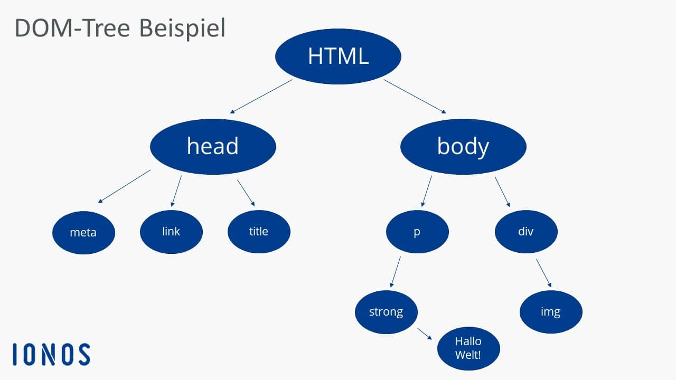
What is DOM ?
Dom is Document Object Model .
Imagine you have an HTML file that contains <div>, <h1>, and <button> tags. When the browser opens this file, it converts it into a tree.
DOM means: converting HTML code into a large object that JavaScript can access, modify, or delete.
In this tree:
Each tag is called a Node.
JavaScript accesses this tree using the document object.

Slide 3
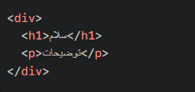
The DOM Tree:
The DOM has a completely hierarchical structure called the “DOM tree.” In this tree:
Everything you see on the page (tags, text, even comments) is a Node.
The <html> tag is the root of the tree.
The tags inside it are like branches of a tree, with a parent-child relationship.
Here div is the parent and h1 and p are its children. Also h1 and p are siblings.

Slide 4
Why is the DOM so important?
Without the DOM, JavaScript is practically useless! The DOM gives JavaScript the following powers:
Change content: Change the text of a paragraph.
Change appearance: Change the color or size of a font with CSS.
Change structure: Remove an element or add a new button.
Respond to the user: Understand where the user clicked.
Important :
When you change something with the DOM, your original HTML file on the server doesn't change! You're only changing what the user sees in their browser (the rendered version in RAM). If the user refreshes the page, everything goes back to the way it was.

Slide 5

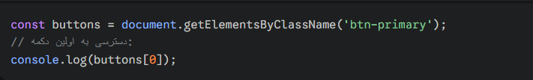
Selecting Elements:
Before you do anything, you need to tell JavaScript which element you are working with.
1. Select by ID - getElementById
This is the fastest and most direct way. Since in HTML each id must be unique, this method always returns only one element.
Output: A single Element Object.
If not found: Returns null.
2.Select by class name - getElementsByClassName
This method finds all elements that have the specified class.
Output: An HTMLCollection (similar to an array but does not have all the array methods like map).
Note: Even if only one element with that class is found, it is still returned as a list.

Slide 6

Selecting Elements:
.3 Select by tag name - getElementsByTagName
Selects all elements that are of a specific tag type (such as all p's or all div's).
Output: An HTMLCollection.
4. Modern Query Selectors - The method you should use more
These methods use the CSS Selectors syntax. This means that whatever way you would select an element in CSS (with a dot for class, a hash for ID, etc.) you do the same here.
A. querySelector
Finds only the first item that matches the condition.

Slide 7
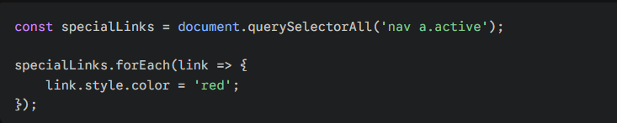
Selecting Elements:
B. querySelectorAll
Finds all elements that match the condition.
Output: a NodeList.
Big advantage: Unlike HTMLCollection, it is possible to use the forEach method directly on this list.

Slide 8
Selecting Elements:
Difference between NodeList and HTMLCollection:
HTMLCollection | NodeList
With getElementsByClassName or getElementsByTagName | With querySelectorAll or childNodes property
It only contains HTML tags (Elements). | It can include tags, texts, and even comments.
The forEach method doesn't have it directly (it must be converted to an array first). | It has a forEach method! You can loop directly through it.

Slide 9
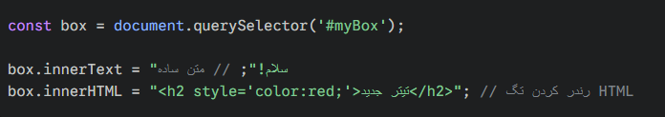
Dom Manipolation:
The Manipulation section is where your site comes to life. In this section, we'll learn how to use JavaScript to change the structure, content, and appearance of a page without refreshing it.
I'll break this down into some main categories:
1. Content Manipulation
There are 3 main ways to change the text or code inside an element:
innerText: Changes only the text and takes CSS styles into account (i.e., it doesn't read text hidden by CSS).
textContent: Returns or changes all the text inside an element (even hidden text) (slightly faster than innerText).
innerHTML: Allows you to write HTML tags inside the element as well.

Slide 10
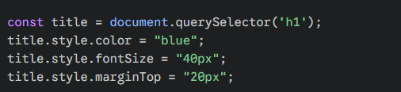
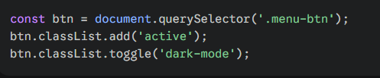
Dom Manipulation:
1. . Changing Styles and Classes (Style & Classes)
This section is the most commonly used section for animations and visual changes.
A) Style Attribute (Direct Style)
This method allows you to apply CSS directly to the element (Inline Style). Note: In JavaScript, two-word names in CSS are written in camelCase (for example, background-color becomes
b) classList attribute (best practice)
Instead of writing individual styles, it is better to define CSS classes in a .css file and add or remove that class to the element with JS.
add('className'): Add a class.
remove('className'): Remove a class.
toggle('className'): Removes the class if it exists, adds it if it doesn't (great for dark/light buttons).
contains('className'): Checks if the element has this class or not (outputs true/false).

Slide 11
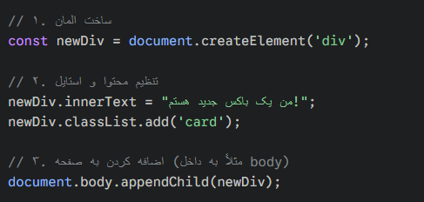
Dom Manipulation:
3.Creating & Removing Elements
Sometimes it is necessary to create an element from scratch and add it to the page (for example, when a user leaves a comment and their comment needs to appear).
document.createElement(tagName): Creates a new element in memory.
parent.appendChild(child): Adds the created element as the last child of a parent.
parent.prepend(child): Adds it as the first child.
element.remove(): Removes the element completely from the page.

Slide 12
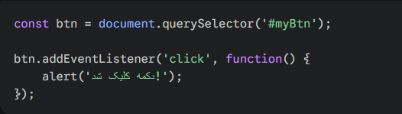
Events:
Events mean: “Whenever such and such happens, execute such and such a function.” Without events, our site is a lifeless statue.
addEventListener
This method takes two parameters: the name of the event (click) and the action to be performed (a function).

Slide 13
Events:
Here is the complete, categorized list of JavaScript critical events:
These are the most commonly used events for buttons and menus.
1. Mouse Events
click: Flagger of events! When the user clicks and releases the left mouse button.
mousedown / mouseup: When the mouse button is pressed and released respectively (great for creating Drag & Drop functionality).
mouseenter / mouseleave: When the mouse pointer enters or leaves the bounds of an element. (Great for complex hovers).
2. Keyboard Events
For when the user types into an Input or plays with the arrow keys.
keydown: The moment the key is pressed (even if held down, it will repeat continuously).
keyup: The moment the user lifts their hand off the key.

Slide 14
Events:
3. Form Events
submit: When the form is submitted. (Reminder: Be sure to call e.preventDefault() here to avoid a page refresh.)
input: Every time the content of an input changes (even by one character). Best for Live Search.
change: When the user changes the value and exits the field (Blur). Great for Checkboxes and Select Boxes.
focus : When the user clicks on a field (enters) and when they exit it.2. Keyboard Events
4. Window & Document Events
These events are for the entire page, not a specific element.
DOMContentLoaded: When the HTML structure is fully loaded (without waiting for images). Best place to start JS code.

Slide 15
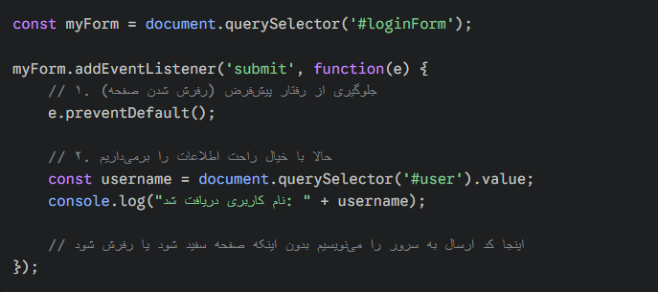
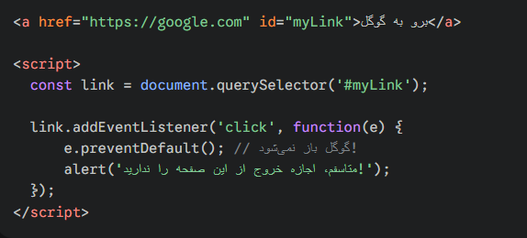
e.preventDefault()
In HTML, some elements have a default behavior. This means that the browser is programmed to do a specific thing when something happens to them.
Two very important examples:
Forms (<form>): When the Submit button is clicked, the browser collects information and sends it to the action address and refreshes the page.
Links (<a>): When you click on a link, the browser takes you to the href address.
e.preventDefault() is a message to the browser that says: "Stop! Don't do your usual behavior, I'm going to handle this myself with JavaScript."

Slide 16
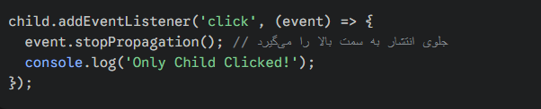
E or Event :
When we create an event listener, JavaScript automatically passes an object containing information about that event to our function. We usually call it e or event. The preventDefault() method is one of the tools inside this object.

